Slide 1
NaviKaran
We support Renewable Energy

Slide 2
Our aim:
Our website is the go to website, if you have decided to switch from non-renewable to renewable energy.
In order to do so we have provided several tools which will help our users to get a perfect match for what they were looking for.

Slide 3
WHY DO WE NEED NAVIKARAN?
Over the years, we have seen how important renewable energy is but if we will go on internet, we don’t really find any website which can really help you with finding the amount of equipment you will need to make using renewable energy reliable.
With Navikaran you get all that at one place.

Slide 4
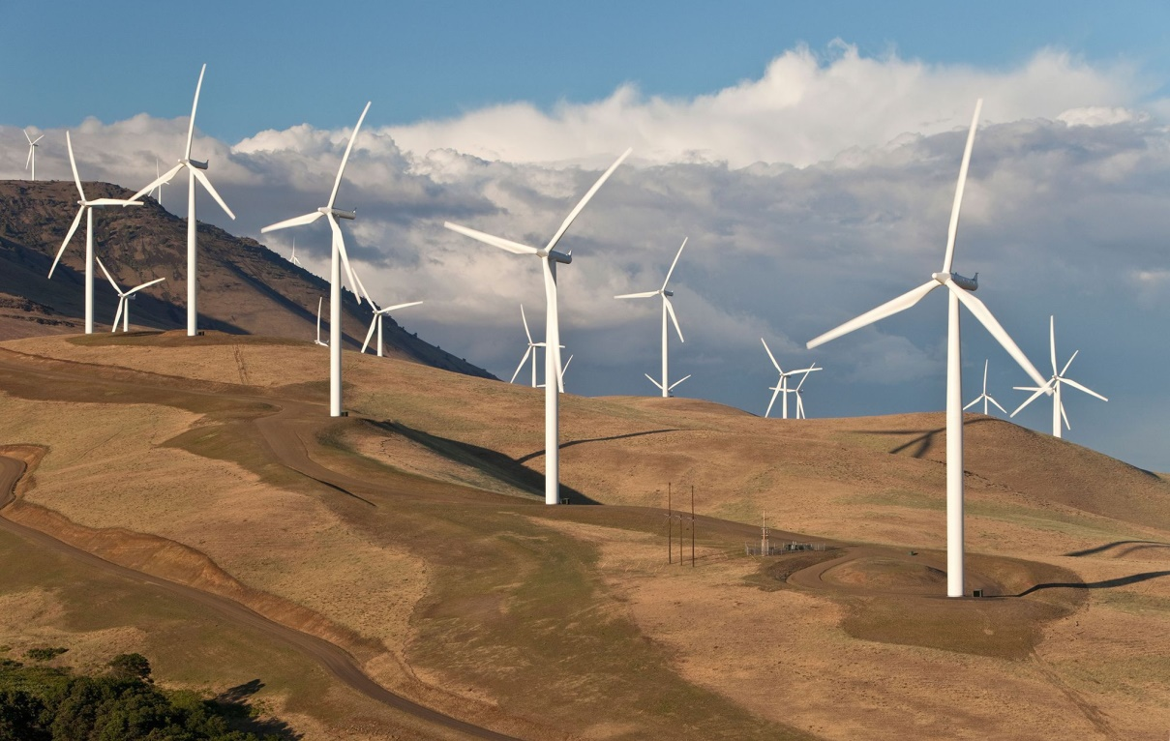
Wind energy:
Wind energy is very efficient and reliable in a region which is not close to the coast and when it comes to India we have many regions which satisfy this condition.

Slide 5
Although wind turbines are very expensive but at the same time they are very efficient and in the right conditions they can easily fulfil electricity needs of 1000+ households.
To make it easier for the user to estimate the power production of a turbine we have also add a calculator which uses Open-Weather api to know about the climate of the region the user wants to know about. With pressure, temperature and wind velocity we can easily estimate the power production of a wind turbine of a given size.

Slide 6
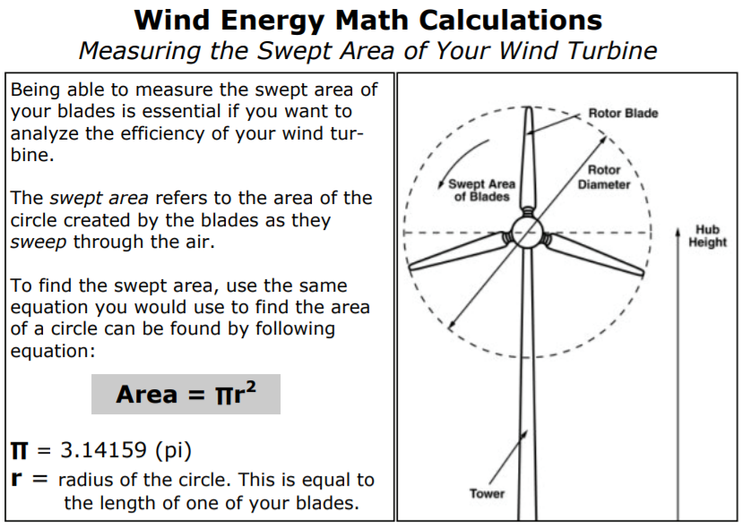
HOW DO WE CALCULATE THE POWER?

Slide 7
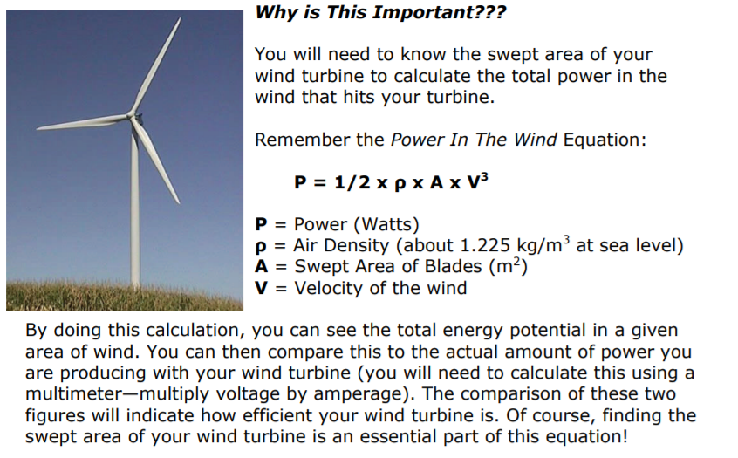

Slide 8
But in real life scenarios, we will also have to few constants into considerations.
1. Coefficient of performance.
(0.35)(0.56 maximum theoretically betz limit)
2. Generator efficiency.
(50% to 80%)
3. Gear box bearing efficiency.
(95%)
Hence the formula will be:

Slide 9
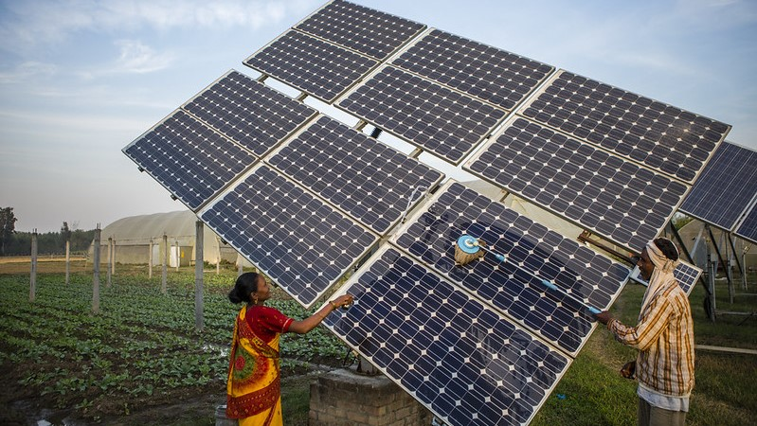
Solar energy:
When it comes to India, we have an abundance of solar energy and the fact that we are still not able to use it to its full capacity is outraging.

Slide 10
Most of us don’t really realise how easy it is to install a solar panel in their households and that is why we came up with this web-site which will help every user to know the advantages, disadvantages and cost of a solar panel.
To make it easier to understand, we have also provided a link to a solar panel cost calculator which takes all the state-wise subsidies into considerations.

Slide 11
Our services
Due to the lack of time, we were only able to make our wind energy and solar energy sections fully functional.
But in few weeks, we will also be able to provide services related to other renewable energy forms like water, biomass and etc.
In NaviKaran, Our primary aim is to make the general population more familiar with renewable energy and show them how useful and efficient it can be at its best.

Slide 12
Updates:
Fully optimised and responsive for mobile and pc.
More renewable resources information will be added.
Calculator for all other resources will be added.
GPS feature will be added.
More accurate results after each update.
Integrated map showing avaibility of different renewable resources in different regions across the world.
Updated and up to date news section on renewable resources.

